Slide 1
LECTURE # 04 INFORMED SEARCH A*

Slide 2



INTRODUCTION
Introduction:
Welcome everyone. Today, we'll delve into the fascinating world of the A* algorithm, commonly pronounced as "A star".
A* is a widely used and versatile pathfinding algorithm that finds the shortest path between two points in a graph.
In this lecture, we'll break down the fundamentals of A*, explore its key components, understand how it works, and discuss its applications.

Slide 3

WHAT IS A* ALGORITHM
What is A Algorithm?*
A* is a combination of Dijkstra's algorithm and a heuristic search.
It efficiently finds the shortest path between two nodes in a graph by using both the actual cost from the start node (g-value) and a heuristic estimate of the cost to the goal node (h-value).
The algorithm aims to minimize the total estimated cost, which is the sum of the actual cost and the heuristic cost.

Slide 4

A* is a heuristic search algorithm
Application Areas: Heuristics are commonly used in various fields, including psychology, economics, computer science, and decision-making. They play a crucial role in artificial intelligence algorithms, such as in heuristic search algorithms like A*.

Slide 5
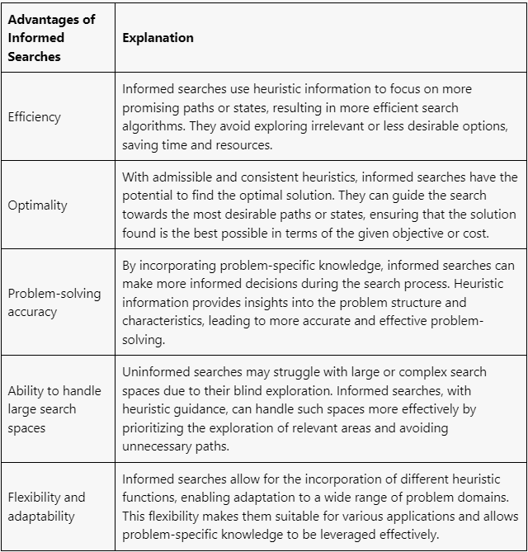
ADVANTAGES OF A*

Slide 6

DISADVANTAGES OF A*
Heuristic quality: The effectiveness of A* heavily relies on the quality of the heuristic function used. A poor or inaccurate heuristic can lead to suboptimal or incorrect solutions. Designing an effective heuristic can be challenging, especially in complex problem domains.
Memory requirements: A* may require a significant amount of memory to store the explored search space and the priority queue used for node selection. In some cases, the memory requirements can be prohibitive, especially for large or complex search spaces.
Time complexity: The time complexity of A* can vary depending on the search space's characteristics and the quality of the heuristic function. In worst-case scenarios, A* may require exponential time, making it inefficient or impractical for certain problem domains.

Slide 7
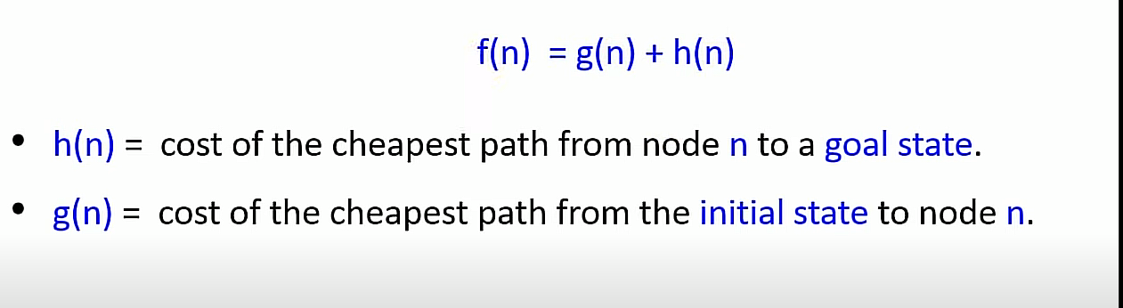
FORMULLA USED IN a* ALGORITHM:

Slide 8
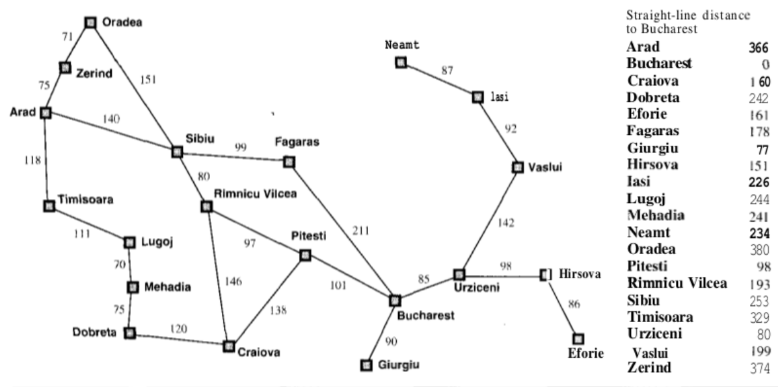
CODE Example IN LAB COLAB

Slide 9
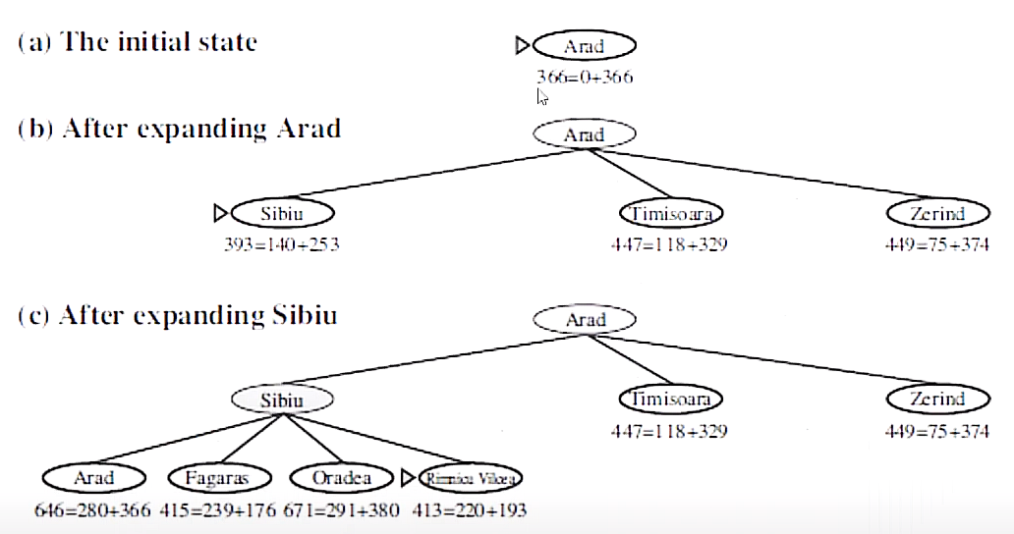
Explanation:

Slide 10
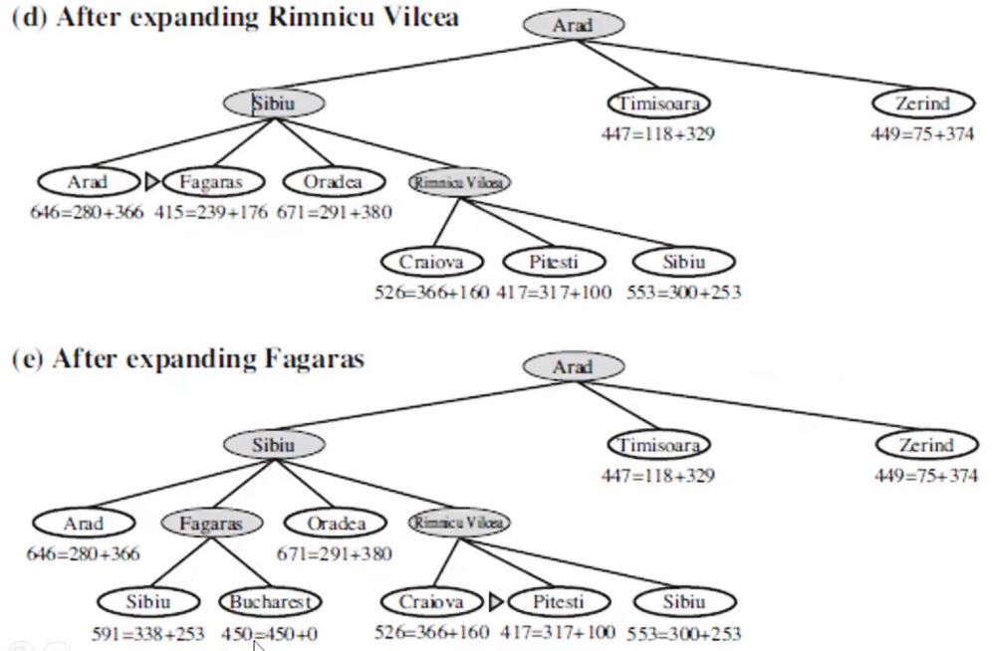
Explaination:

Slide 11
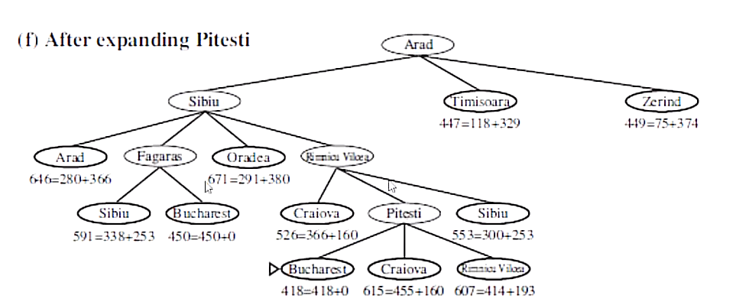
Explanation:

Slide 12
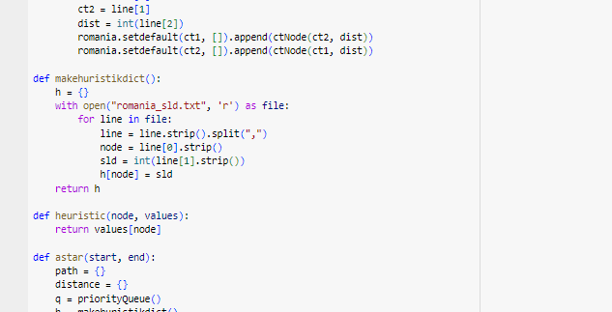

Slide 13
Code explanation

Slide 14
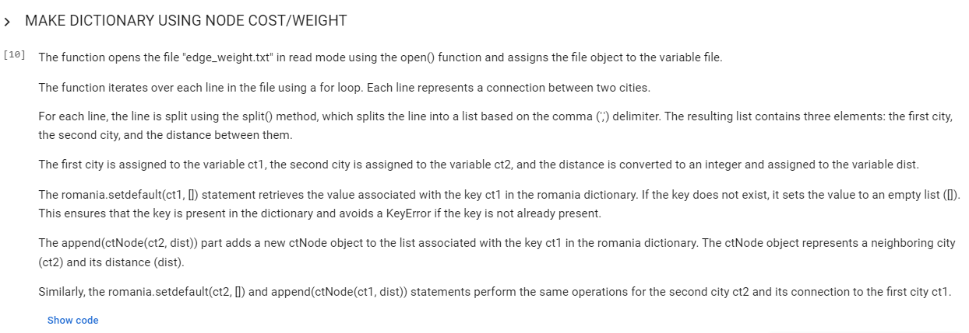
Code explanation

Slide 15
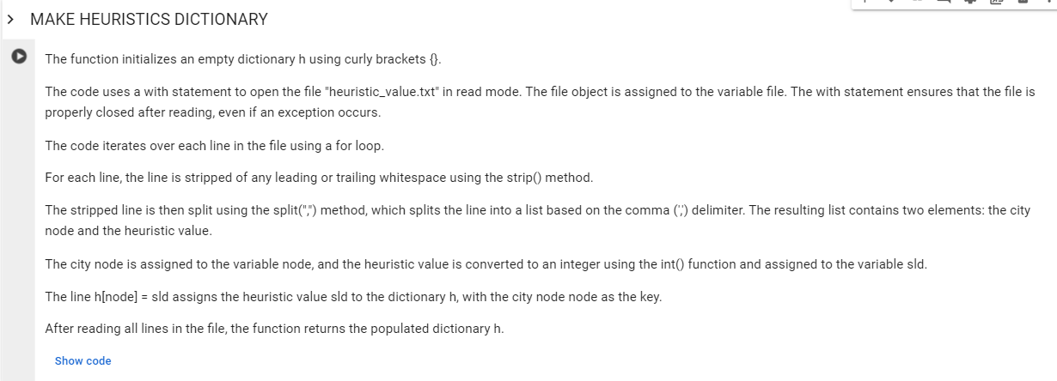
Code explanation

Slide 16
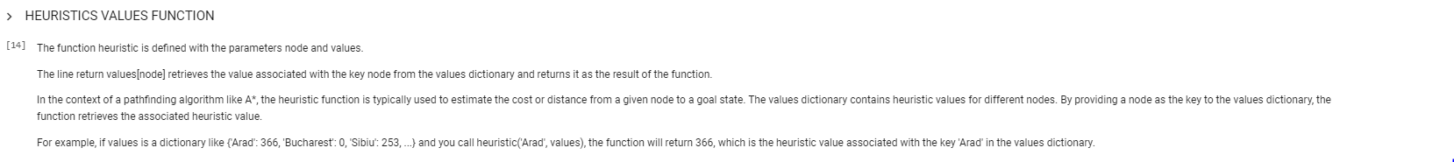
Code explanation

Slide 17
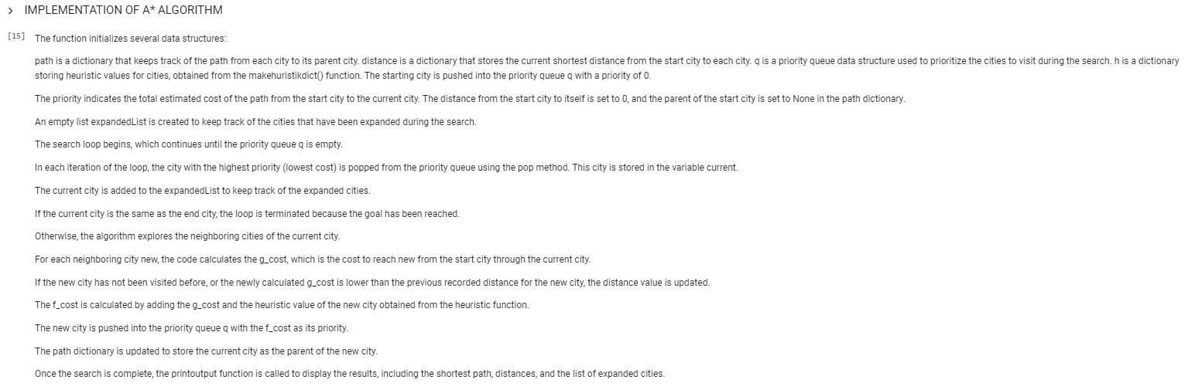
Code explanation

Slide 18
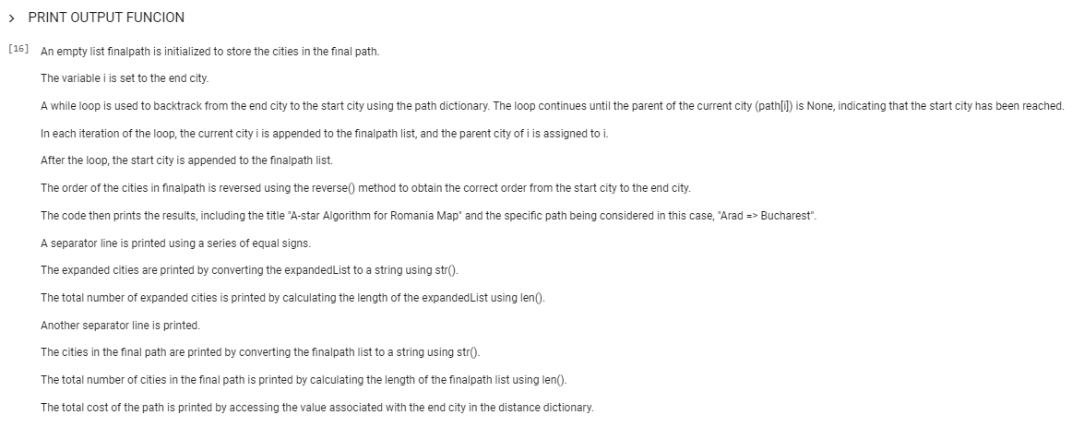
Code explanation

Slide 19
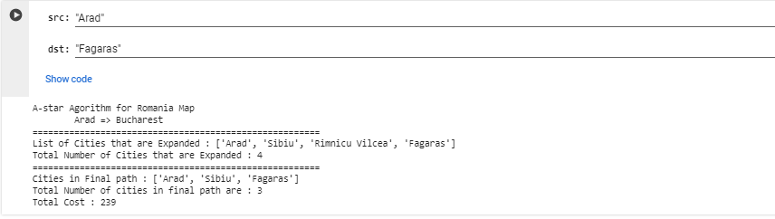
Code explanation

Slide 20
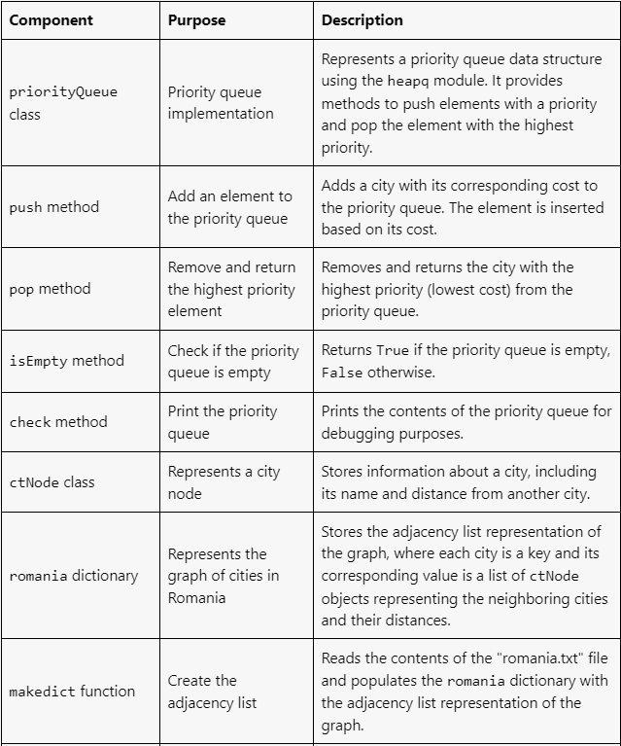
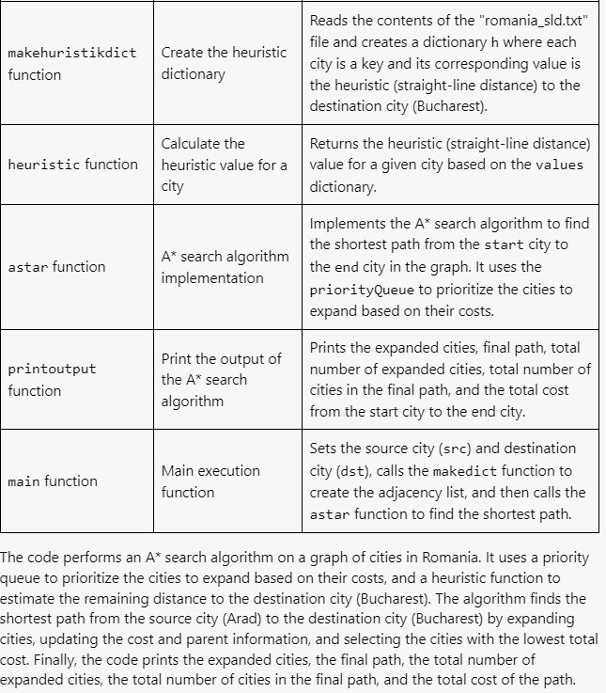
Explanation:

Slide 21
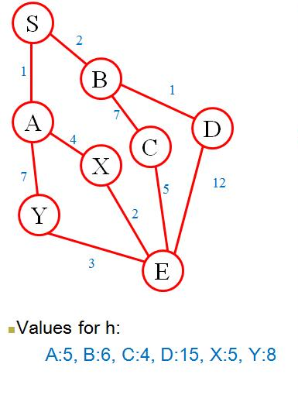
Task:
Implement A* Search and find the optimal path for finding the goal
Start = S
Goal = E

Slide 22
TASK 3: Arad to neamt using A* aLGORITHM
HEURISTIC VALUE

